Slide 1
Operating Systems
Chapter 6 Concurrency: Deadlock(死锁) and Starvation(饥饿)

Slide 2
6.1 Principles of Deadlock
6.1 Principles of Deadlock
6.2 Deadlock Prevention
6.3 Deadlock Avoidance
6.4 Deadlock Detection
6.5 An Integrated Deadlock Strategy
6.6 Dining Philosophers Problem
6.7 Summary

Slide 3
Deadlock
Permanent blocking of a set of processes that either compete for system resources or communicate with each other
No efficient solution in the general case(通用)
All deadlock involve conflicting needs for resources by two or more processes (死锁源于两个或者多个进程的资源需求冲突).
  A common example is the traffic deadlock (交通死锁)
Notes:
either compete for system resources or communicate with each other 要么争夺系统资源，要么互相等待对方的消息

Slide 4
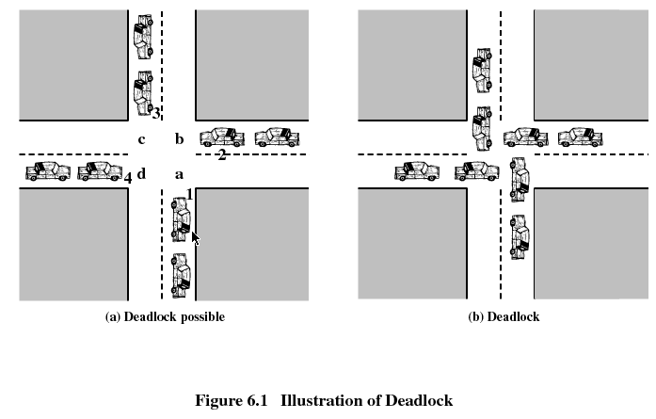

Slide 5
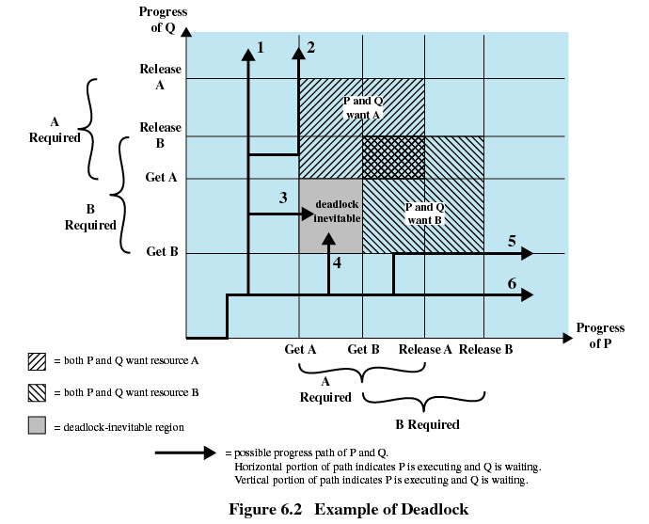

Slide 6
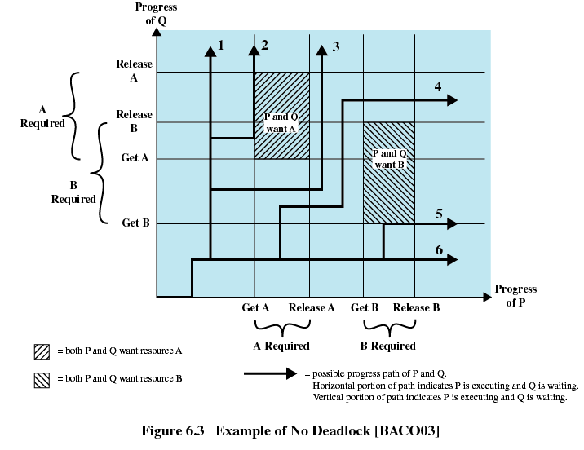

Slide 7
Resources Categories(资源的分类)
Reusable Resources(可重用资源)
Consumable Resources(可消费资源)
Notes:
可消耗资源是指可以被创建(生产)和销毁(消耗)的资源。

Slide 8
6.1 Principles of Deadlock
6.1.1 Reusable Resources
6.1.2 Consumable Resources
6.1.3 Resource Allocation Graphs
6.1.4 The Conditions for Deadlock

Slide 9
Reusable Resources(可重用资源)
Used by only one process at a time and not depleted(耗尽) by that use
Processes obtain resources that they later release for reuse by other processes
Examples include processors, I/O channels, main and secondary memory, devices, and data structures such as files, databases

Slide 10
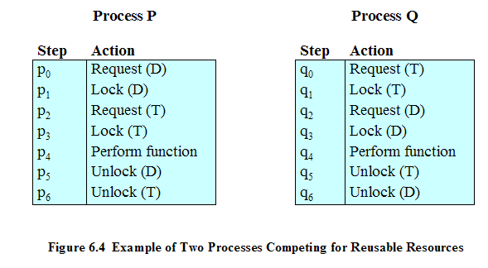
Deadlock Example of Reusable Resources
Interleaves the execution: p0 p1 q0 q1 p2 q2
Notes:
Interleaves 交替

Slide 11
Another Deadlock Example of Reusable Resources
Space is available for allocation of 200Kbytes, and the following sequence of events occur
Deadlock occurs if both processes progress to their second request
P1
P2
. . .
. . .
Request 80 Kbytes;
Request 70 Kbytes;
. . .
. . .
Request 60 Kbytes;
Request 80 Kbytes;

Slide 12
6.1 Principles of Deadlock
6.1.1 Reusable Resources
6.1.2 Consumable Resources
6.1.3 Resource Allocation Graphs
6.1.4 The Conditions for Deadlock

Slide 13
Consumable Resources(可消费资源)
May be created (produced) and destroyed (consumed) by processes
Examples include interrupts, signals, messages, and information in I/O buffers

Slide 14
Deadlock Example of Consumable Resources
Deadlock occurs if receive is blocking
P1
P2
. . .
. . .
Receive(P2);
Receive(P1);
. . .
. . .
Send(P2, M1);
Send(P1, M2);

Slide 15
6.1 Principles of Deadlock
6.1.1 Reusable Resources
6.1.2 Consumable Resources
6.1.3 Resource Allocation Graphs
6.1.4 The Conditions for Deadlock

Slide 16
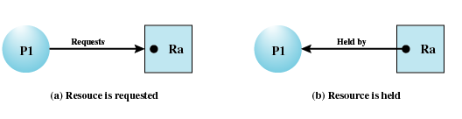
Resource Allocation Graphs(资源分配图)
Directed graph(有向图) that depicts(表述) a state of the system of resources and processes

Slide 17
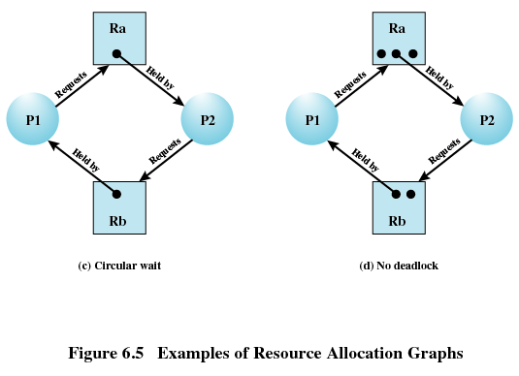
Resource Allocation Graphs

Slide 18
6.1 Principles of Deadlock
6.1.1 Reusable Resources
6.1.2 Consumable Resources
6.1.3 Resource Allocation Graphs
6.1.4 The Conditions for Deadlock

Slide 19
Conditions for Deadlock(死锁的条件)
Mutual exclusion(互斥)
  A resource may used only by one process at a time
Hold-and-wait(占有且等待)
  A process may hold allocated resources while awaiting assignment of others
No preemption(非抢占)
  No resource can be forcibly removed from a process holding it

Slide 20
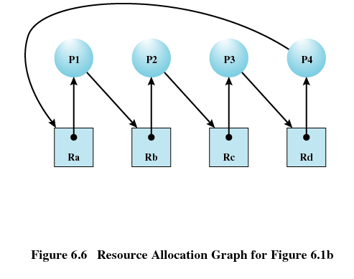
Conditions for Deadlock
Circular wait(循环等待)
  A closed chain of processes exists, such that each process holds at least one resource needed by the next process in the chain

Slide 21
Possibility of Deadlock(死锁的可能性)
Mutual Exclusion
Hold and wait
No preemption（抢占权）
Notes:
Preemption 抢占权

Slide 22
Existence of Deadlock(死锁的存在性)
Mutual Exclusion
Hold and wait
No preemption
Circular wait

Slide 23
Agenda
6.1 Principles of Deadlock
6.2 Deadlock Prevention
6.3 Deadlock Avoidance
6.4 Deadlock Detection
6.5 An Integrated Deadlock Strategy
6.6 Dining Philosophers Problem
6.7 Summary

Slide 24
Deadlock Prevention(死锁预防)
Mutual Exclusion
  Must be supported by the operating system
Hold and Wait
  Require a process request all of its required resources at one time

Slide 25
Deadlock Prevention
No Preemption
  Process must release resource and request again
  Operating system may preempt a process to require it releases its resources
Circular Wait
  Define a linear ordering of resource types
Notes:
Preemption 优先权

Slide 26
Agenda
6.1 Principles of Deadlock
6.2 Deadlock Prevention
6.3 Deadlock Avoidance
6.4 Deadlock Detection
6.5 An Integrated Deadlock Strategy
6.6 Dining Philosophers Problem
6.7 Summary

Slide 27
Deadlock Avoidance(死锁避免)
A decision is made dynamically whether the current resource allocation request will, if granted, potentially lead to a deadlock
Requires knowledge of future resource requests
Notes:
potentially 潜在

Slide 28
Two Approaches to
Deadlock Avoidance
Process Initiation Denial
  Do not start a process if its demands might lead to deadlock(如果一个进程的请求会导致死锁，则不启动此进程，进程启动拒绝)
Resource Allocation Denial
  Do not grant an incremental resource request to a process if this allocation might lead to deadlock(如果一个进程增加资源的请求会导致死锁，则不容许此分配，资源分配拒绝)

Slide 29
Resource Allocation Denial
Referred to as the banker’s algorithm
State of the system(系统状态) is the current allocation of resources to process
Safe state(安全状态) is where there is at least one sequence that does not result in deadlock
Unsafe state(不安全状态) is a state that is not safe

Slide 30
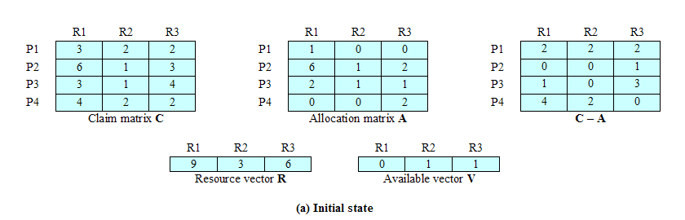
Determination of a Safe State a.Initial State

Slide 31
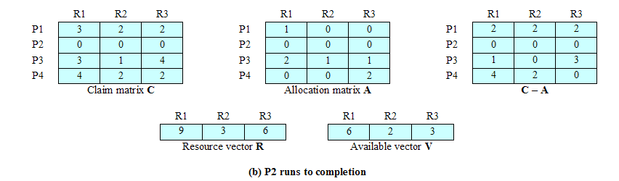
Determination of a Safe State b.P2 Runs to Completion

Slide 32
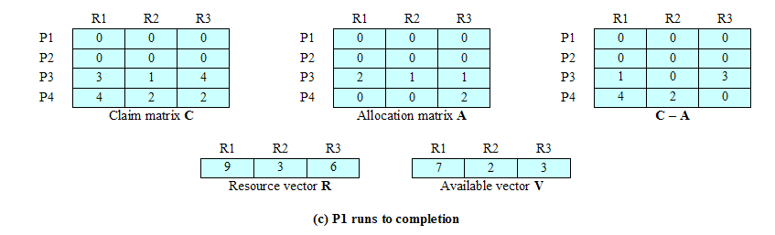
Determination of a Safe State c. P1 Runs to Completion

Slide 33
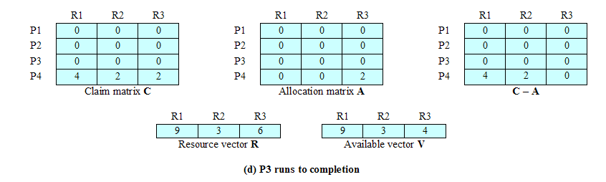
Determination of a Safe State d. P3 Runs to Completion

Slide 34
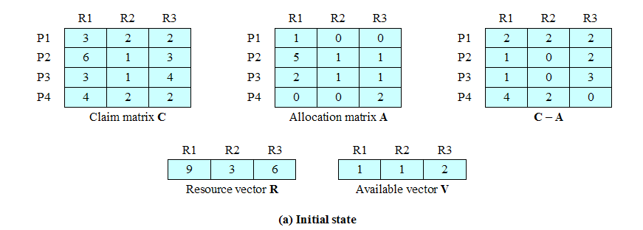
Determination of an
Unsafe State
P1 request for one additional unit each of R1 and R3

Slide 35
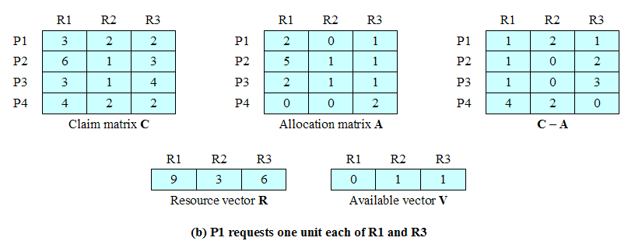
Determination of an
Unsafe State

Slide 36
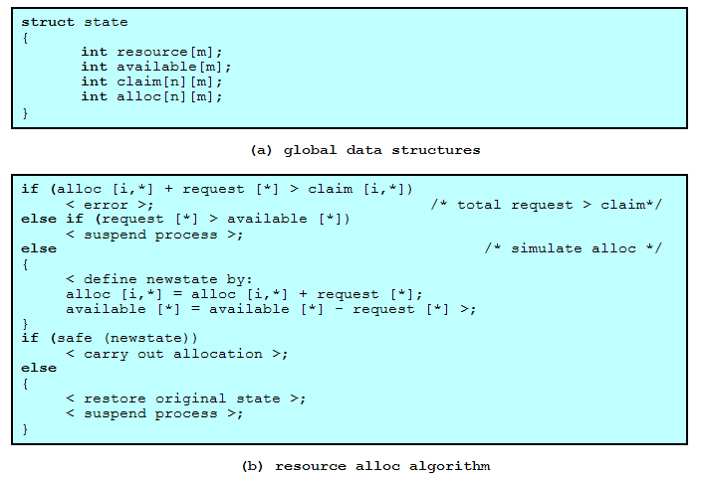
Deadlock Avoidance Logic(死锁避免逻辑)

Slide 37
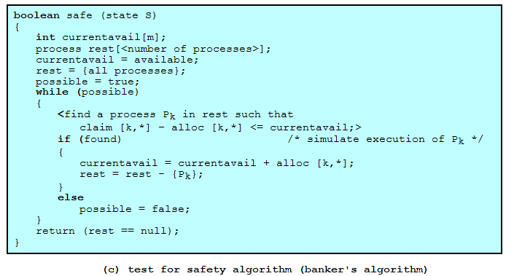
Deadlock Avoidance Logic

Slide 38
Restrictions of Deadlock Avoidance
Maximum resource requirement must be stated in advance
Processes under consideration must be independent; no synchronization requirements
There must be a fixed number of resources to allocate
No process may exit while holding resources

Slide 39
Agenda
6.1 Principles of Deadlock
6.2 Deadlock Prevention
6.3 Deadlock Avoidance
6.4 Deadlock Detection
6.5 An Integrated Deadlock Strategy
6.6 Dining Philosophers Problem
6.7 Summary

Slide 40
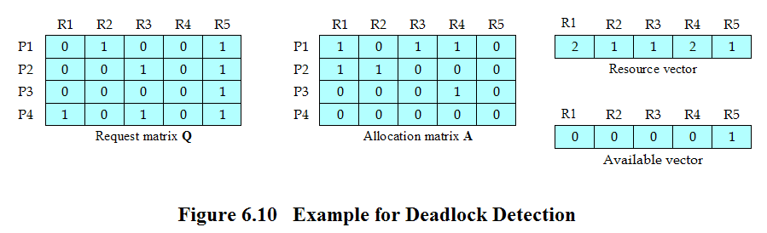
Deadlock Detection
Reference the textbook for deadlock detection algorithm

Slide 41
Recovery Strategies Once Deadlock Detected (死锁检测到后的解锁策略)
Abort all deadlocked processes
Back up (回滚) each deadlocked process to some previously defined checkpoint, and restart all process
  Original deadlock may occur
Successively abort (连续取消) deadlocked processes until deadlock no longer exists
Successively preempt (连续剥夺) resources until deadlock no longer exists
Notes:
该方法的风险是原来的死锁可能再次发生

Slide 42
Selection Criteria Deadlocked Processes （被剥夺或者取消进程的选择标准）
Least amount of processor time consumed so far
Least number of lines of output produced so far
Most estimated time remaining
Least total resources allocated so far
Lowest priority

Slide 43
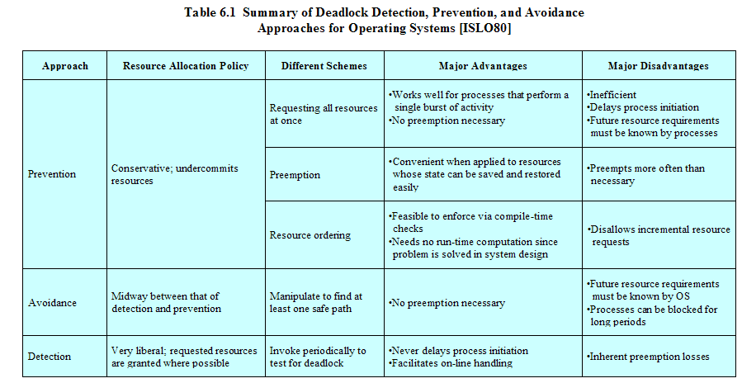
Strengths and Weaknesses of the Strategies
Notes:
内生竞争丢失

Slide 44

Whatever, Deadlock(1/1)
What’s it meaning?
Reasonable?
Notes:
不管怎样，僵局

Slide 45
Agenda
6.1 Principles of Deadlock
6.2 Deadlock Prevention
6.3 Deadlock Avoidance
6.4 Deadlock Detection
6.5 An Integrated Deadlock Strategy
6.6 Dining Philosophers Problem
6.7 Summary

Slide 46
An Integrated Deadlock Strategy(一种综合死锁策略)
Group resources into a number of different resource classes(资源分类)
Use the linear ordering strategy(线性排序策略) defined previously for the prevention of circular wait to prevent deadlocks between resource classes(类与类之间用线性排序策略避免死锁)
Within a resource class, use the algorithm that is most appropriate for that class(每个类中使用适合于该类的策略)

Slide 47
Agenda
6.1 Principles of Deadlock
6.2 Deadlock Prevention
6.3 Deadlock Avoidance
6.4 Deadlock Detection
6.5 An Integrated Deadlock Strategy
6.6 Dining Philosophers Problem
6.7 Summary

Slide 48
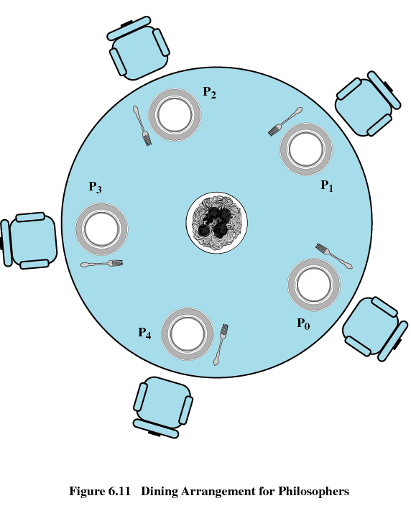
Dining Philosophers Problem(哲学家就餐问题)

Slide 49
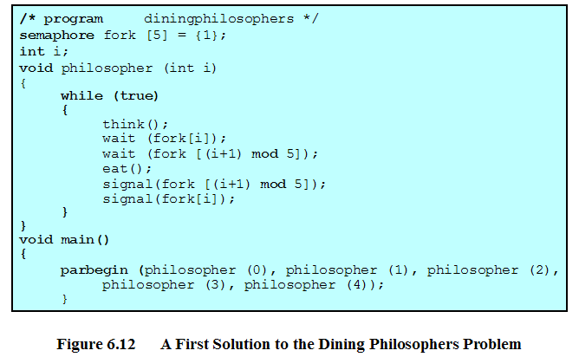
Dining Philosophers Problem (incorrect)

Slide 50
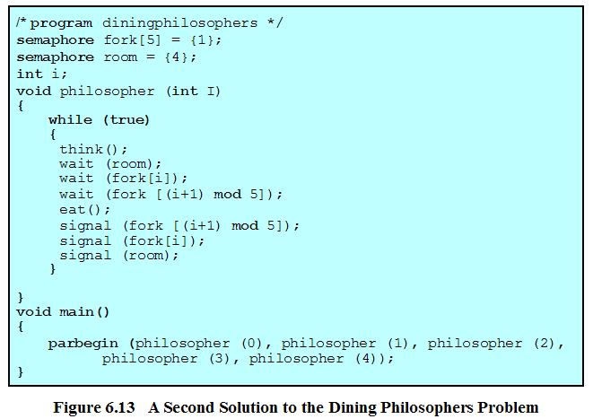
Dining Philosophers Problem

Slide 51
Agenda
6.1 Principles of Deadlock
6.2 Deadlock Prevention
6.3 Deadlock Avoidance
6.4 Deadlock Detection
6.5 An Integrated Deadlock Strategy
6.6 Dining Philosophers Problem
6.7 Summary

